Slide 1
Computer Graphics 2-D Transformation
Slides of: T. Mariah Khayat – Special Thanks

Slide 2

Main Reference
Computer Graphics with Open GL, 4th edition, Hearn, Baker & Carithers.

Slide 3
Chapter Six
Two-Dimensional Geometric Transformations

Slide 4
Content
Basic Two-Dimensional Geometric Transformations
Other Two-Dimensional Transformations

Slide 5
Geometric Transformations
Operations that are applied to the geometric description of an object to change its position, orientation, or size are called geometric transformations.
Sometimes geometric transformations are also referred to as modeling transformations, but some graphics packages make a distinction between the two.
Notes:
Modeling Transformation as we have discussed before, is to model each distinct object in the whole scene in a separate coordinate called Modeling coordinate, that describes how those components are to be fitted into the overall picture or scene.

Slide 6
Basic Two-Dimensional Geometric Transformations
The geometric-transformation functions that are available in all graphics packages are those for translation, rotation, and scaling.
Other useful transformation routines that are sometimes included in a package are reflection and shearing operations.
To introduce the general concepts associated with geometric transformations, we first consider operations in two dimensions.
Notes:
Shearing = Cutting = Clipping.

Slide 7
Translation

Slide 8
Two-Dimensional Translation
We perform a translation on a single coordinate point by adding offsets to its coordinates so as to generate a new coordinate position.
In effect, we are moving the original point position along a straight-line path to its new location.
Similarly, a translation is applied to an object that is defined with multiple coordinate positions, such as a quadrilateral, by relocating all the coordinate positions by the same displacement along parallel paths.
Then the complete object is displayed at the new location.

Slide 9
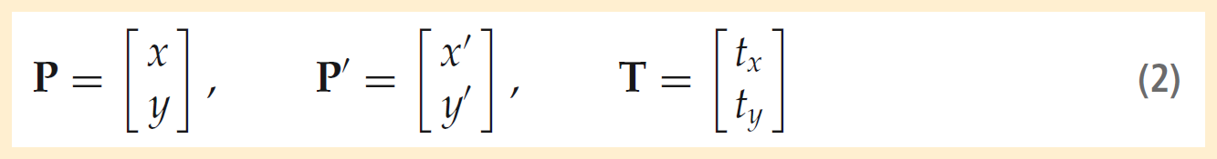
Two-Dimensional Translation
To translate a two-dimensional position, we add translation distances tx and ty to the original coordinates (x, y) to obtain the new coordinate position (x’, y’) as shown in Figure 1.
The translation distance pair (tx, ty) is called a translation vector or shift vector.
We can express Equations 1 as a single matrix equation by using the following column vectors to represent coordinate positions and the translation vector:

Slide 10
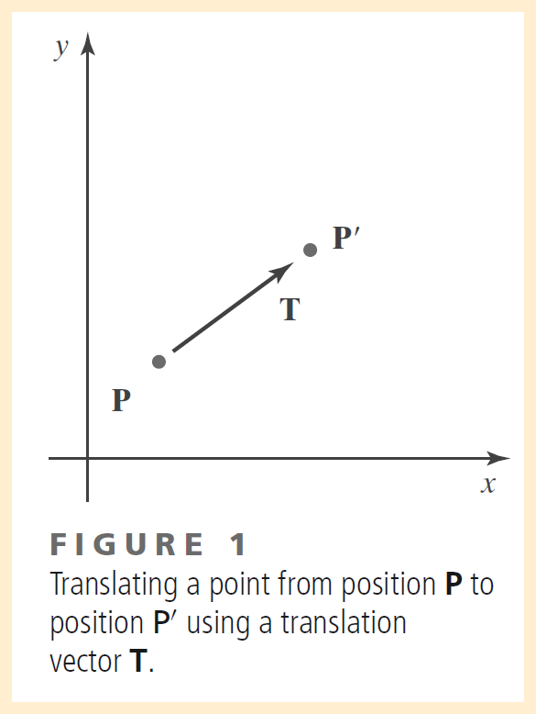
Two-Dimensional Translation

Slide 11
Two-Dimensional Translation
This allows us to write the two-dimensional translation equations in the matrix form

Slide 12
Two-Dimensional Translation
Translation is a rigid-body transformation that moves objects without deformation.
That is, every point on the object is translated by the same amount.
A straight-line segment is translated by applying Equation 3 to each of the two line endpoints and redrawing the line between the new endpoint positions.
A polygon is translated similarly. We add a translation vector to the coordinate position of each vertex and then regenerate the polygon using the new set of vertex coordinates.
Notes:
Deformation = Distortion.

Slide 13
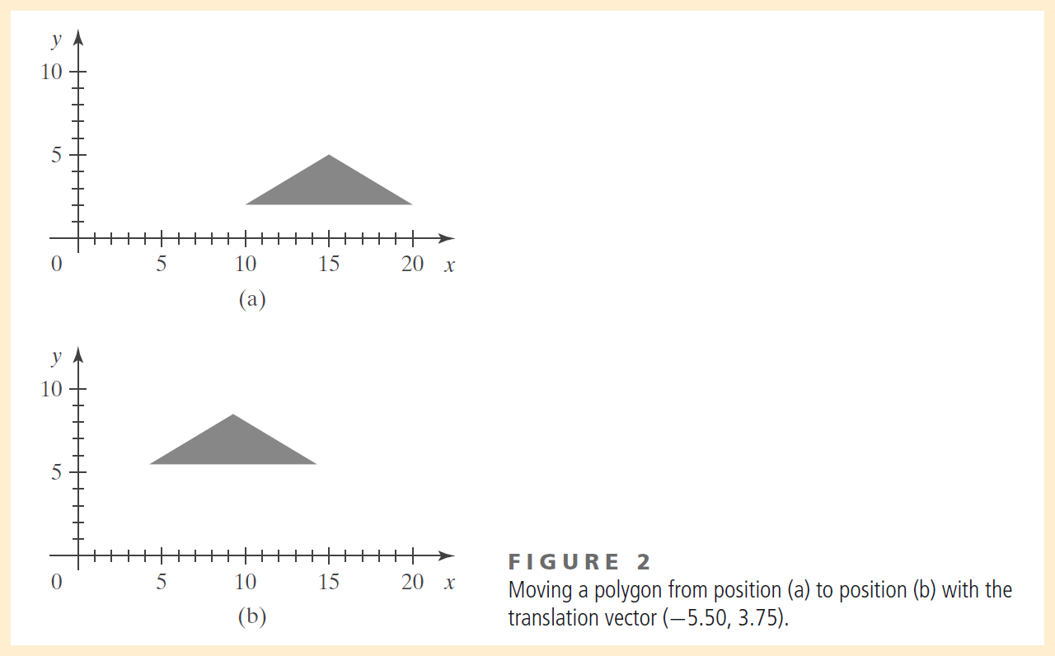
Two-Dimensional Translation
Figure 2 illustrates the application of a specified translation vector to move an object from one position to another.

Slide 14
Two-Dimensional Translation
Similar methods are used to translate other objects.
To change the position of a circle or ellipse, we translate the center coordinates and redraw the figure in the new location.
For a spline curve, we translate the points that define the curve path and then reconstruct the curve sections between the new coordinate positions.

Slide 15
Rotation

Slide 16
Two-Dimensional Rotation
We generate a rotation transformation of an object by specifying a rotation axis and a rotation angle.
All points of the object are then transformed to new positions by rotating the points through the specified angle about the rotation axis.

Slide 17
Two-Dimensional Rotation
A two-dimensional rotation of an object is obtained by repositioning the object along a circular path in the xy plane.
In this case, we are rotating the object about a rotation axis that is perpendicular to the xy plane (parallel to the coordinate z axis).
Parameters for the two-dimensional rotation are the rotation angle θ and a position (xr , yr ), called the rotation point (or pivot point), about which the object is to be rotated (Figure 3).
The pivot point is the intersection position of the rotation axis with the xy plane.
Notes:
Perpendicular = Orthogonal = Vertical.
Pivot = Axes = Center.

Slide 18
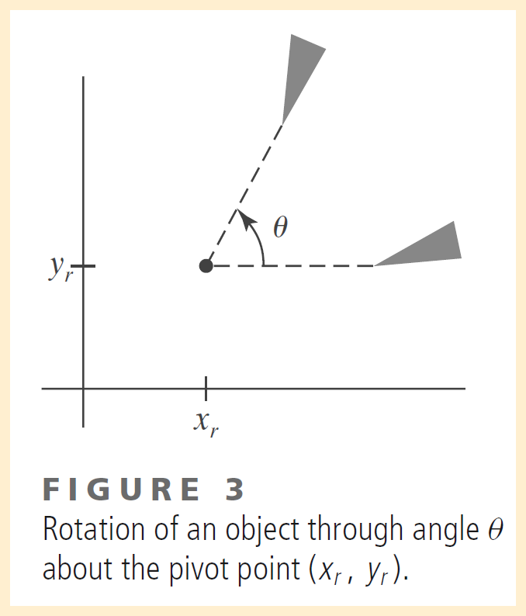
Two-Dimensional Rotation

Slide 19
Two-Dimensional Rotation
A positive value for the angle θ defines a counterclockwise rotation about the pivot point, as in Figure 3, and a negative value rotates objects in the clockwise direction.
To simplify the explanation of the basic method, we first determine the transformation equations for rotation of a point position P when the pivot point is at the coordinate origin.
The angular and coordinate relationships of the original and transformed point positions are shown in Figure 4.

Slide 20
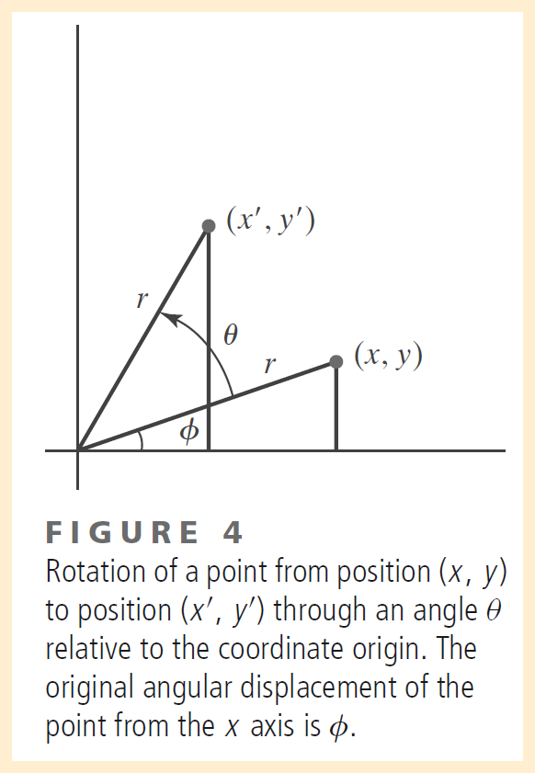
Two-Dimensional Rotation

Slide 21
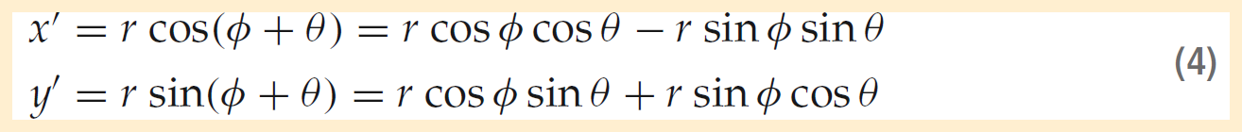
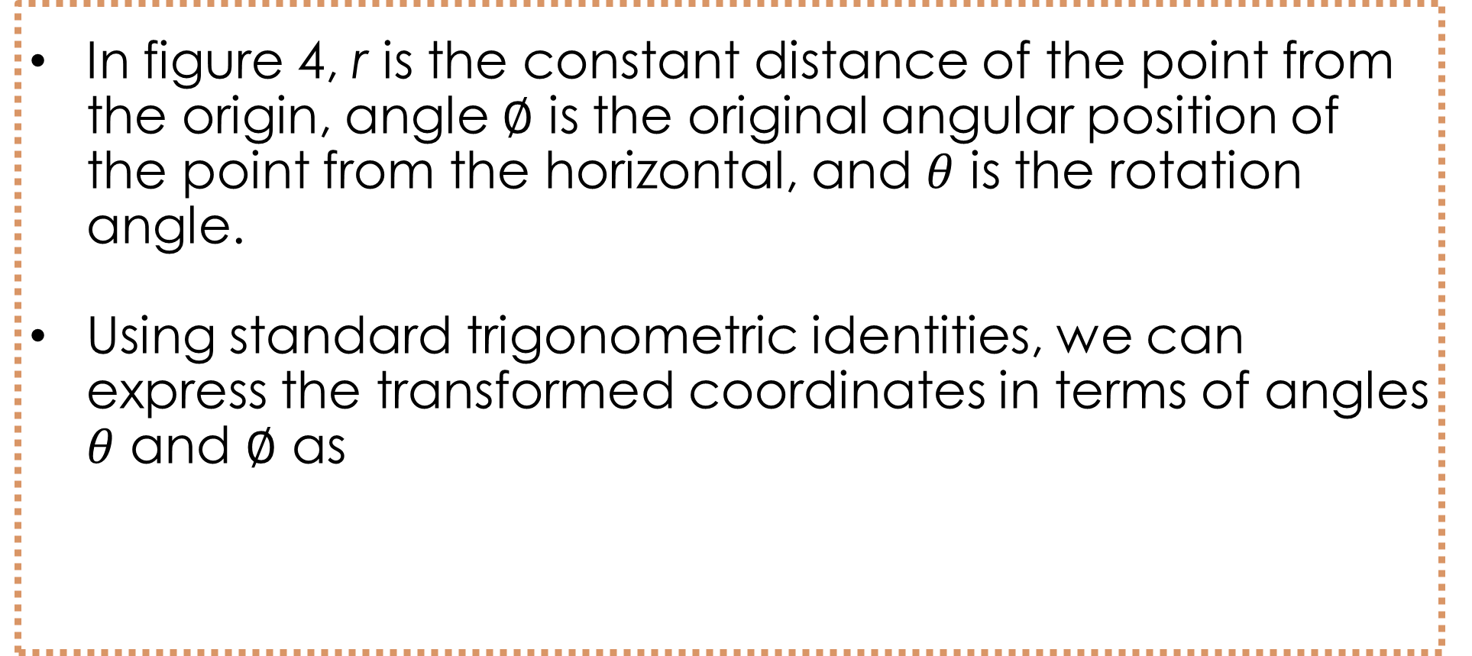
Two-Dimensional Rotation
In figure 4, r is the constant distance of the point from the origin, angle $∅$ is the original angular position of the point from the horizontal, and $θ$ is the rotation angle.
Using standard trigonometric identities, we can express the transformed coordinates in terms of angles $θ$ and $∅$ as

Slide 22
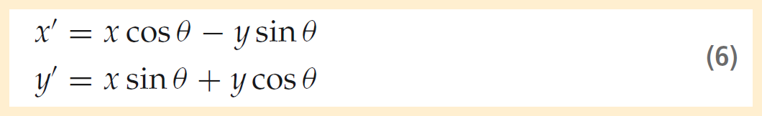
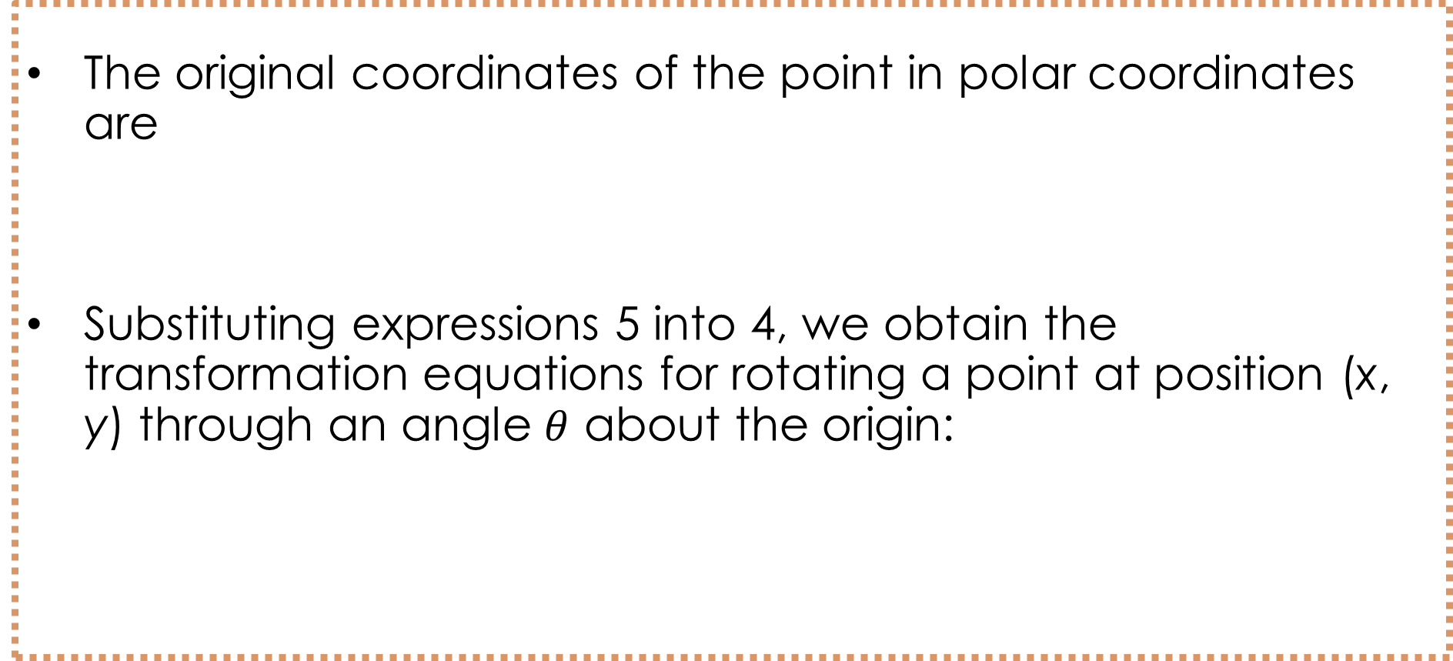
Two-Dimensional Rotation
The original coordinates of the point in polar coordinates are
Substituting expressions 5 into 4, we obtain the transformation equations for rotating a point at position (x, y) through an angle $θ$ about the origin:

Slide 23
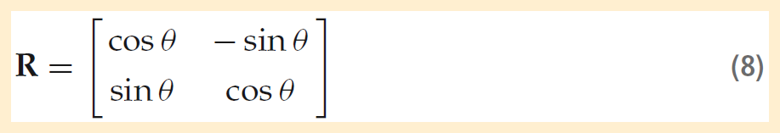
Two-Dimensional Rotation
With the column-vector representations 2 for coordinate positions, we can write the rotation equations in the matrix form
where the rotation matrix is

Slide 24
Two-Dimensional Rotation
A column-vector representation for a coordinate position P, as in Equations 2, is standard mathematical notation.
However, early graphics systems sometimes used a row-vector representation for point positions.
This changes the order in which the matrix multiplication for a rotation would be performed.
But now, graphics packages such as OpenGL, Java, PHIGS, and GKS all follow the standard column-vector convention.

Slide 25
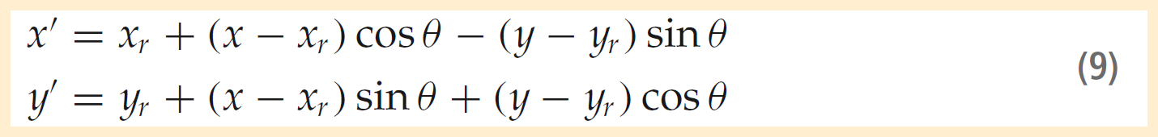
Two-Dimensional Rotation
Rotation of a point about an arbitrary pivot position is illustrated in Figure 5.
Using the trigonometric relationships indicated by the two right triangles in this figure, we can generalize Equations 6 to obtain the transformation equations for rotation of a point about any specified rotation position (xr , yr ):
These general rotation equations differ from Equations 6 by the inclusion of additive terms, as well as the multiplicative factors on the coordinate values.

Slide 26
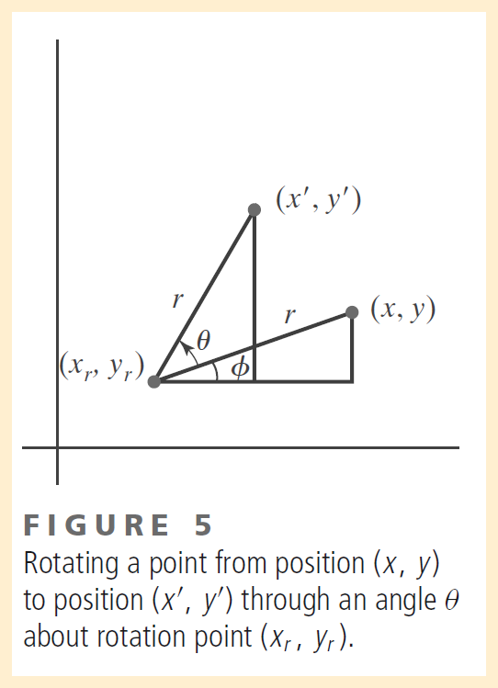
Two-Dimensional Rotation

Slide 27
Two-Dimensional Rotation
As with translations, rotations are rigid-body transformations that move objects without deformation.
Every point on an object is rotated through the same angle.
A straight-line segment is rotated by applying Equations 9 to each of the two line endpoints and redrawing the line between the new endpoint positions.

Slide 28
Two-Dimensional Rotation
A polygon is rotated by displacing each vertex using the specified rotation angle and then regenerating the polygon using the new vertices.
We rotate a curve by repositioning the defining points for the curve and then redrawing it.
A circle or an ellipse, for instance, can be rotated about a noncentral pivot point by moving the center position through the arc that subtends the specified rotation angle.
In addition, we could rotate an ellipse about its center coordinates simply by rotating the major and minor axes.

Slide 29
Two-Dimensional Rotation
In the following code example, a polygon is rotated about a specified world coordinate pivot point.
Parameters input to the rotation procedure are the original vertices of the polygon, the pivot-point coordinates, and the rotation angle theta specified in radians.
Following the transformation of the vertex positions, the polygon is regenerated using OpenGL routines.

Slide 30
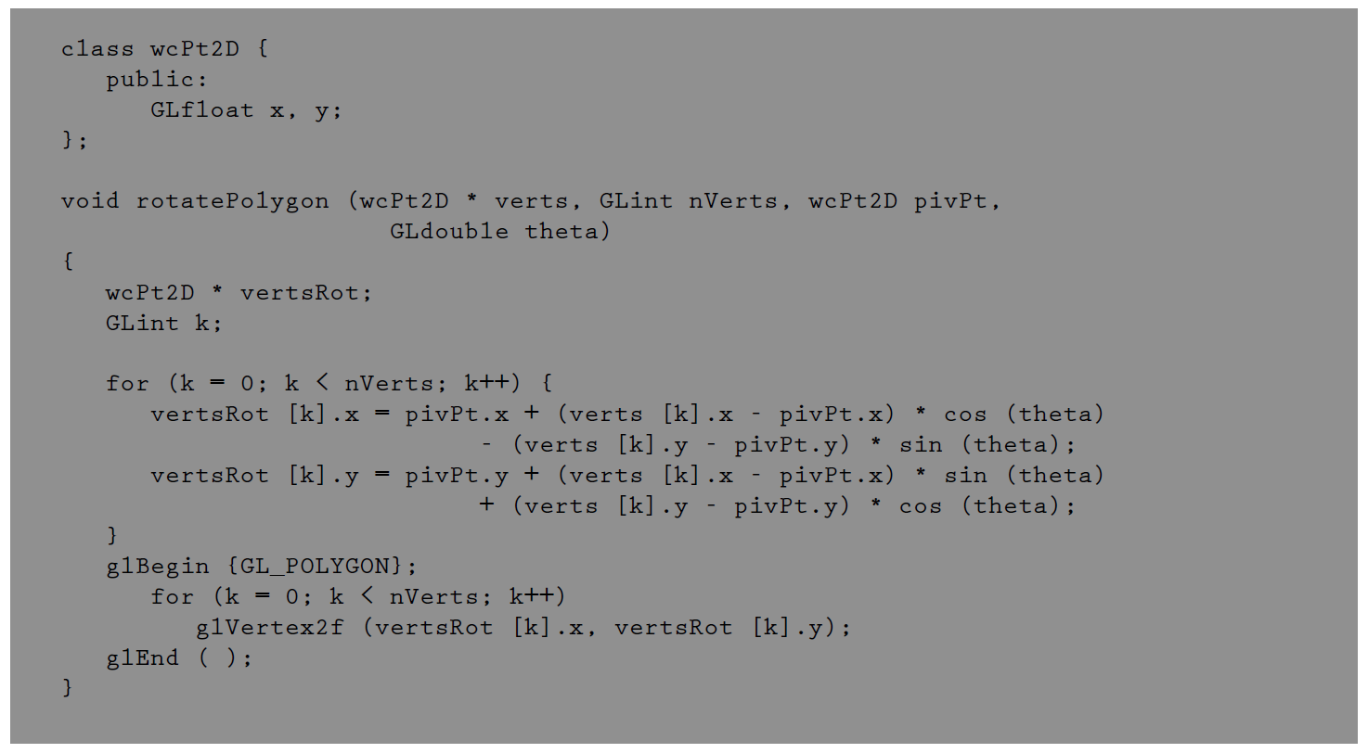
Two-Dimensional Rotation

Slide 31
Two-Dimensional Scaling
To alter the size of an object, we apply a scaling transformation.
A simple two dimensional scaling operation is performed by multiplying object positions (x, y) by scaling factors sx and sy to produce the transformed coordinates (x’, y’):

Slide 32
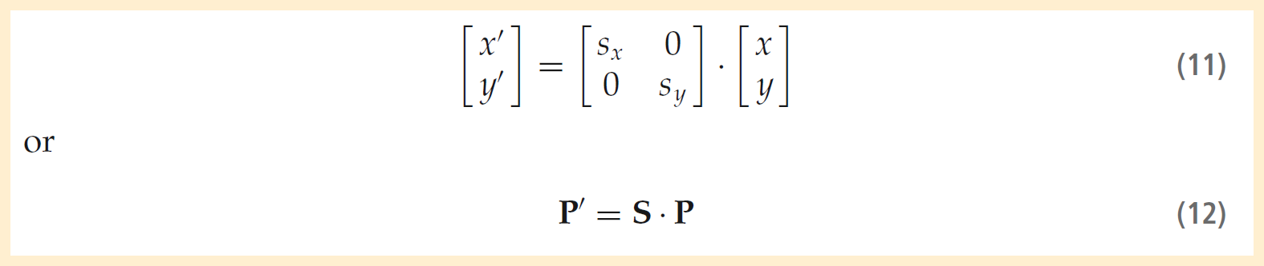
Two-Dimensional Scaling
Scaling factor sx scales an object in the x direction, while sy scales in the y direction.
The basic two-dimensional scaling equations 10 can also be written in the following matrix form:
where S is the 2 × 2 scaling matrix in Equation 11.

Slide 33
Two-Dimensional Scaling
Any positive values can be assigned to the scaling factors sx and sy.
Values less than 1 reduce the size of objects; values greater than 1 produce enlargements.
Specifying a value of 1 for both sx and sy leaves the size of objects unchanged.
When sx and sy are assigned the same value, a uniform scaling is produced, which maintains relative object proportions.
Unequal values for sx and sy result in a differential scaling that is often used in design applications, where pictures are constructed from a few basic shapes that can be adjusted by scaling and positioning transformations (Figure 6).

Slide 34
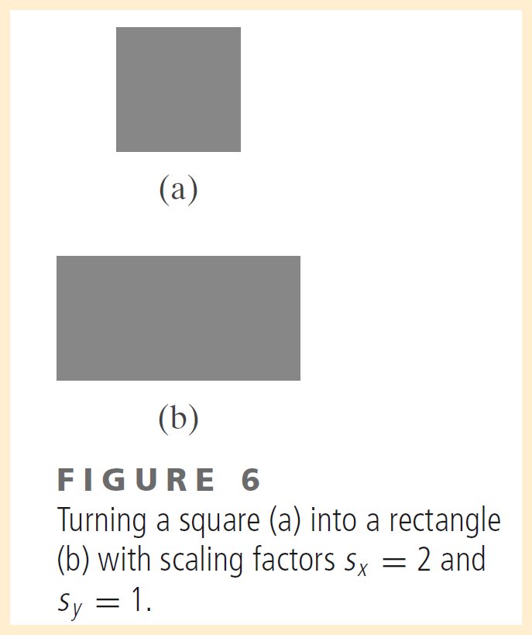
Two-Dimensional Scaling

Slide 35
Two-Dimensional Scaling
In some systems, negative values can also be specified for the scaling parameters.
This not only resizes an object, it reflects it about one or more of the coordinate axes.
Objects transformed with Equation 11 are both scaled and repositioned.

Slide 36
Two-Dimensional Scaling
Scaling factors with absolute values less than 1 move objects closer to the coordinate origin, while absolute values greater than 1 move coordinate positions farther from the origin.
Figure 7 illustrates scaling of a line by assigning the value 0.5 to both sx and sy in Equation 11. Both the line length and the distance from the origin are reduced by a factor of 1/2.

Slide 37
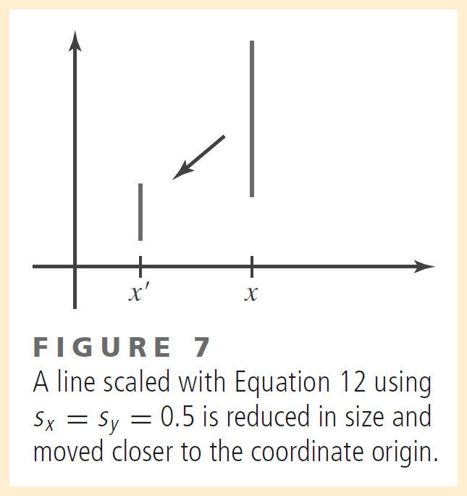
Two-Dimensional Scaling

Slide 38
Two-Dimensional Scaling
We can control the location of a scaled object by choosing a position, called the fixed point, that is to remain unchanged after the scaling transformation.
Coordinates for the fixed point, (xf , yf ), are often chosen at some object position, such as its centroid, but any other spatial position can be selected.
Objects are now resized by scaling the distances between object points and the point (Figure 8).

Slide 39
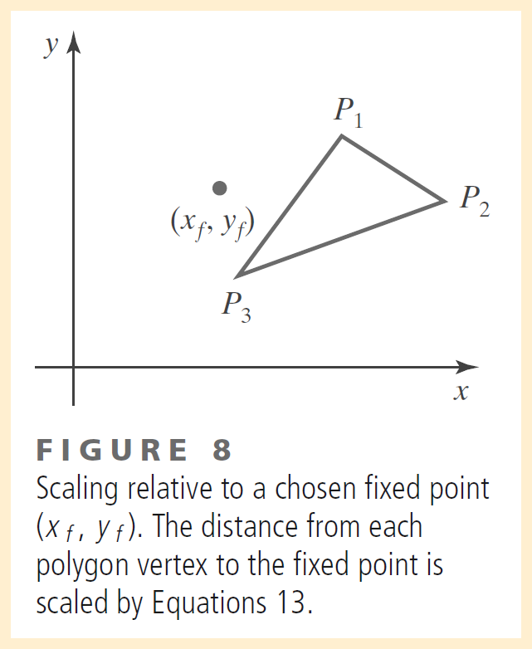
Two-Dimensional Scaling

Slide 40
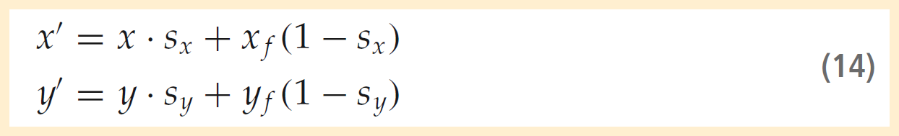
Two-Dimensional Scaling
For a coordinate position (x, y), the scaled coordinates (x, y) are then calculated from the following relationships:
We can rewrite Equations 13 to separate the multiplicative and additive terms as
where the additive terms xf (1 − sx) and yf (1 − sy) are constants for all points in the object.

Slide 41
Two-Dimensional Scaling
Polygons are scaled by applying transformations 14 to each vertex, then regenerating the polygon using the transformed vertices.
For other objects, we apply the scaling transformation equations to the parameters defining the objects.
To change the size of a circle, we can scale its radius and calculate the new coordinate positions around the circumference.
And to change the size of an ellipse, we apply scaling parameters to its two axes and then plot the new ellipse positions about its center coordinates.

Slide 42
Two-Dimensional Scaling
The following procedure illustrates an application of the scaling calculations for a polygon.
Coordinates for the polygon vertices and for the fixed point are input parameters, along with the scaling factors.
After the coordinate transformations, OpenGL routines are used to generate the scaled polygon.

Slide 43
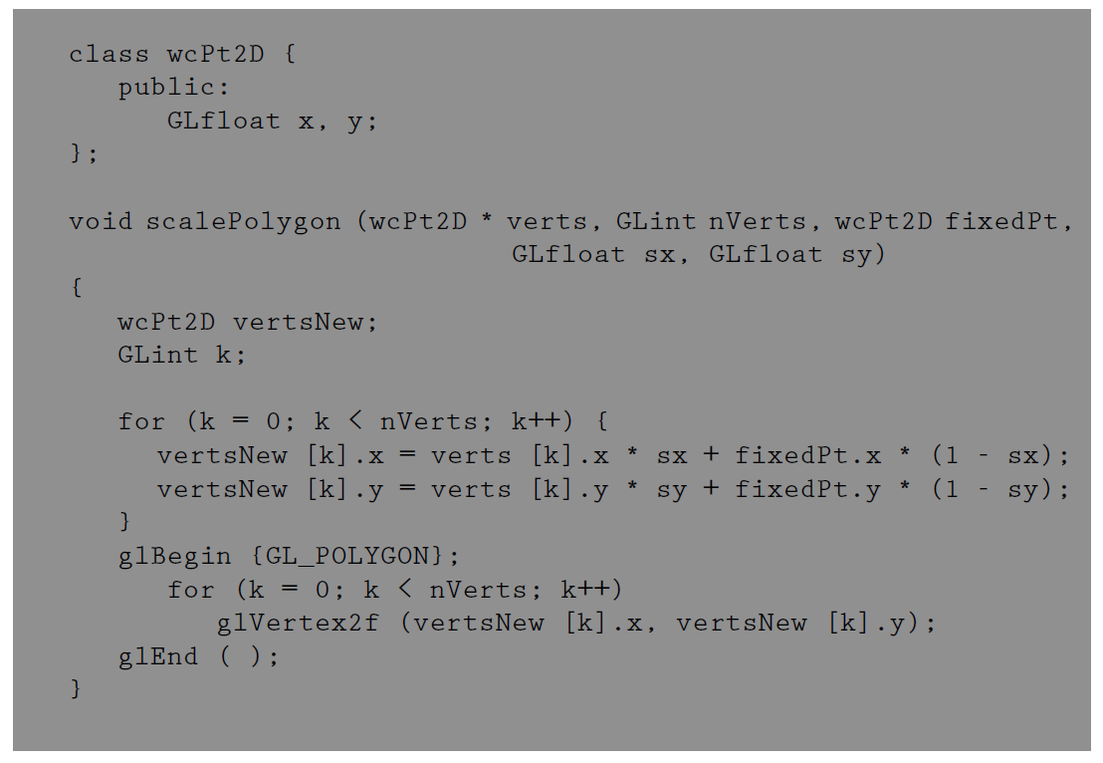
Two-Dimensional Scaling

Slide 44
Other Two-Dimensional Transformations
Basic transformations such as translation, rotation, and scaling are standard components of graphics libraries.
Some packages provide a few additional transformations that are useful in certain applications.
Two such transformations are reflection and shear.

Slide 45
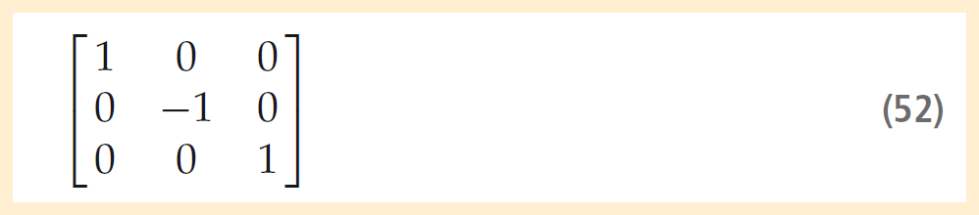
Reflection
A transformation that produces a mirror image of an object is called a reflection.
Some examples of common reflection are:
Reflection about the line y = 0 (the x axis) is accomplished with the transformation matrix
Notes:
This transformation retains x values, but “flips” the y values of coordinate positions.
The resulting orientation of an object after it has been reflected about the x axis is shown in Figure 16.

Slide 46
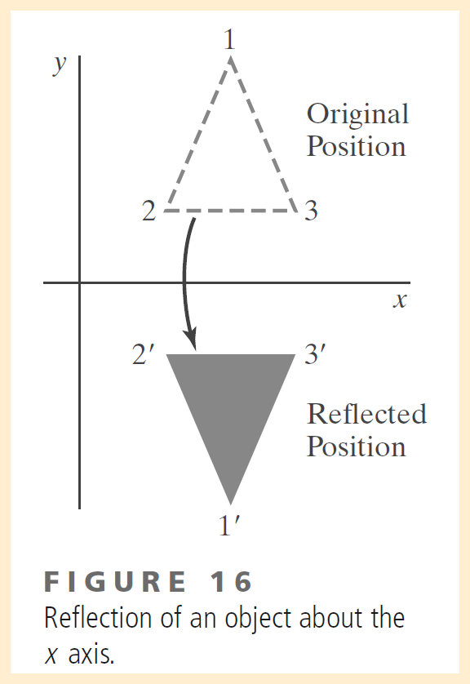
Reflection

Slide 47
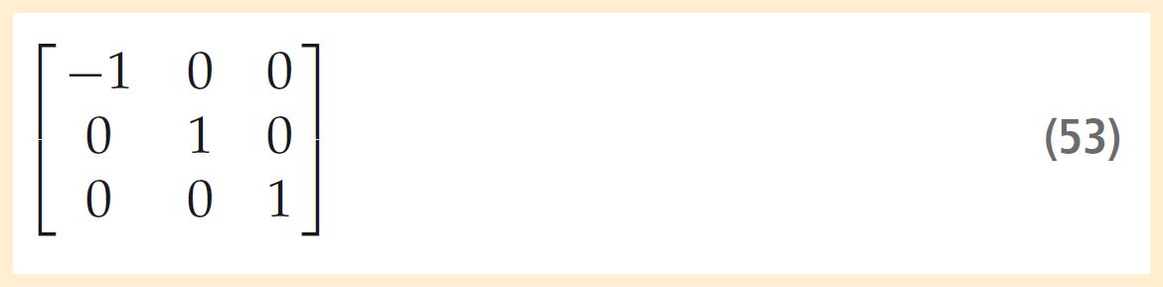
Reflection
A reflection about the line x = 0 (the y axis) flips x coordinates while keeping y coordinates the same. The matrix for this transformation is

Slide 48
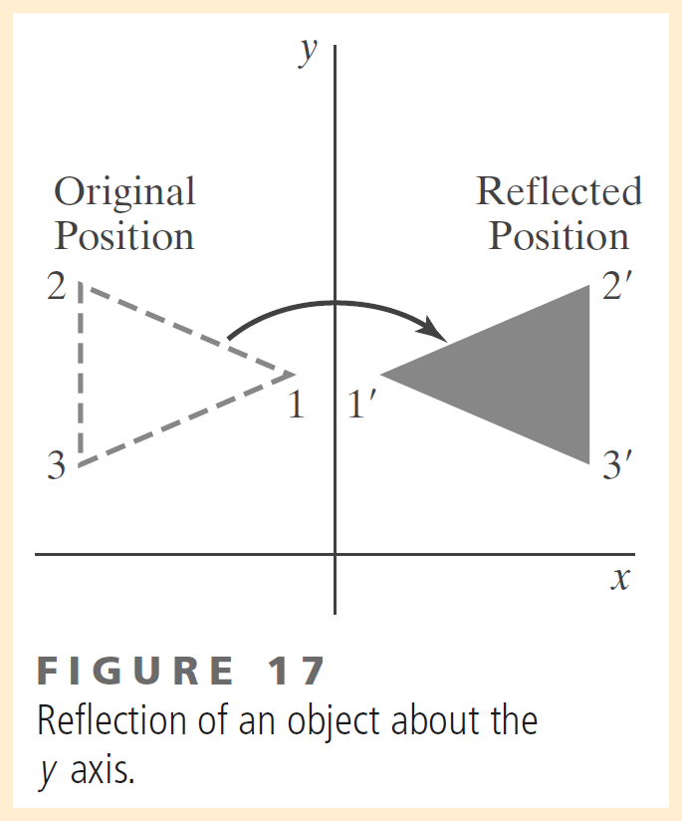
Reflection
Notes:
Figure 17 illustrates the change in position of an object that has been reflected about the line x = 0.

Slide 49
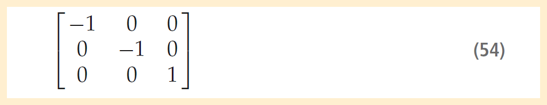
Reflection
This reflection is sometimes referred to as a reflection relative to the coordinate origin. The matrix representation for this reflection is

Slide 50
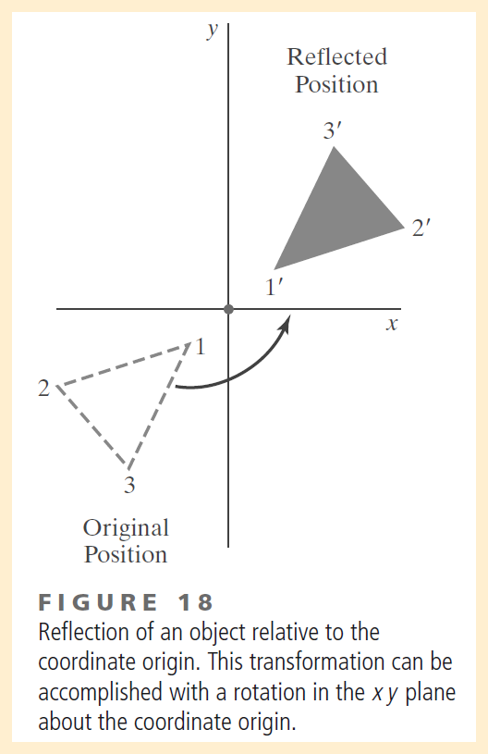
Reflection

Slide 51
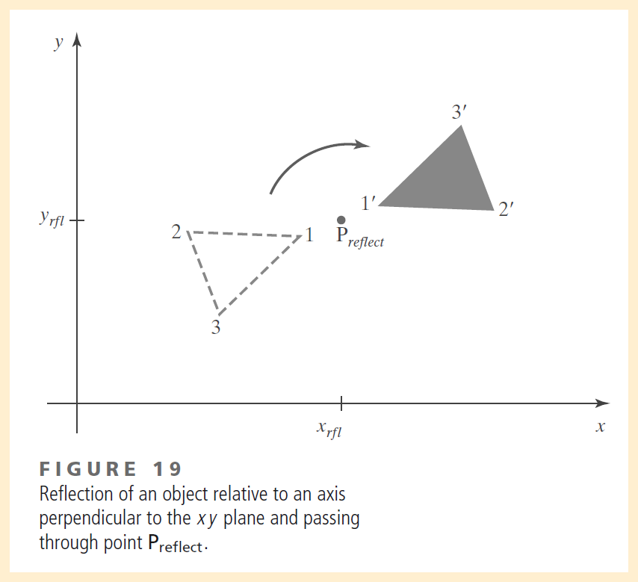
Reflection
Notes:
Reflection 54 can be generalized to any reflection point in the xy plane (Figure 19).

Slide 52
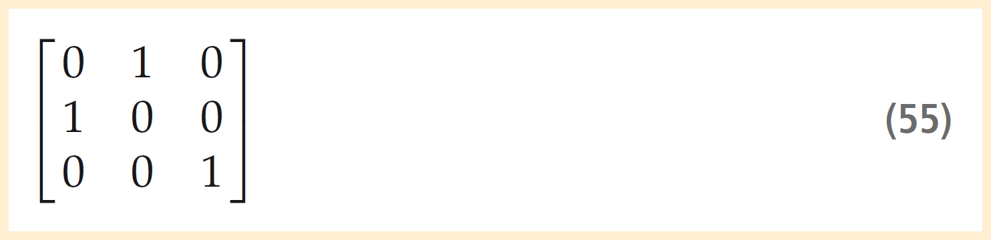
Reflection
If we choose the reflection axis as the diagonal line y = x (Figure 20), the reflection matrix is
We can derive this matrix by concatenating a sequence of rotation and coordinateaxis reflection matrices.
One possible sequence is shown in Figure 21.

Slide 53
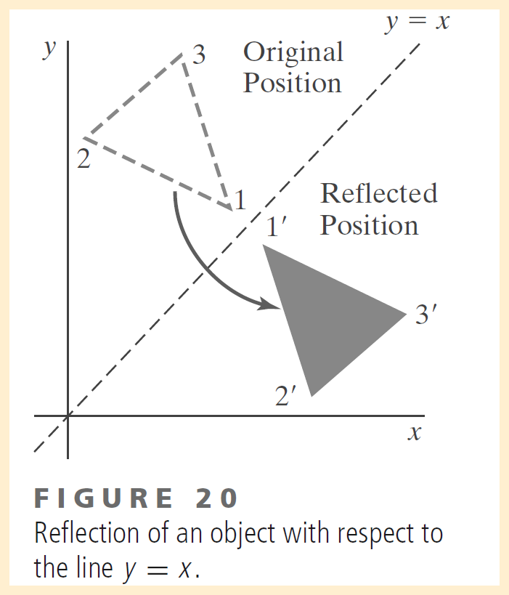
Reflection

Slide 54
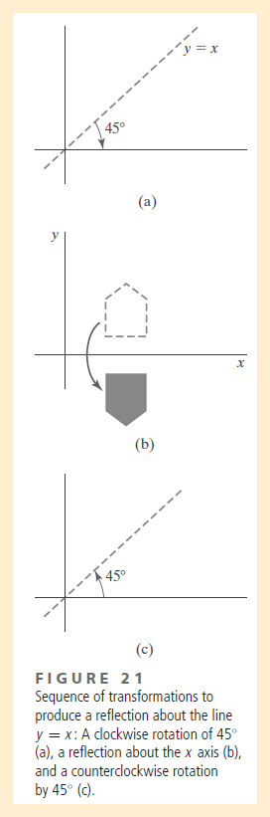
Reflection
Notes:
Here, we first perform a clockwise rotation with respect to the origin through a 45◦ angle, which rotates the line y = x onto the x axis.
Next, we perform a reflection with respect to the x axis.
The final step is to rotate the line y = x back to its original position with a counterclockwise rotation through 45◦.
Another equivalent sequence of transformations is to first reflect the object about the x axis, then rotate it counterclockwise 90◦.

Slide 55
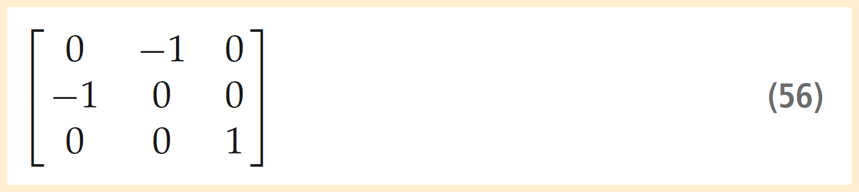
Reflection
To obtain a transformation matrix for reflection about the diagonal y = −x, we could concatenate matrices for the transformation sequence: (1) clockwise rotation by 45◦, (2) reflection about the y axis, and (3) counterclockwise rotation by 45◦. The resulting transformation matrix is
Figure 22 shows the original and final positions for an object transformed with this reflection matrix.

Slide 56
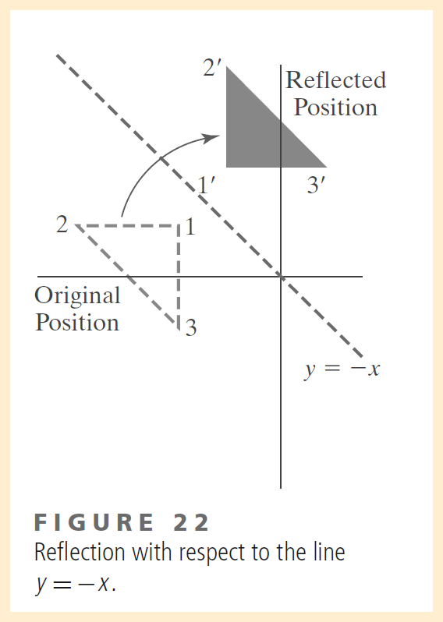
Reflection

Slide 57
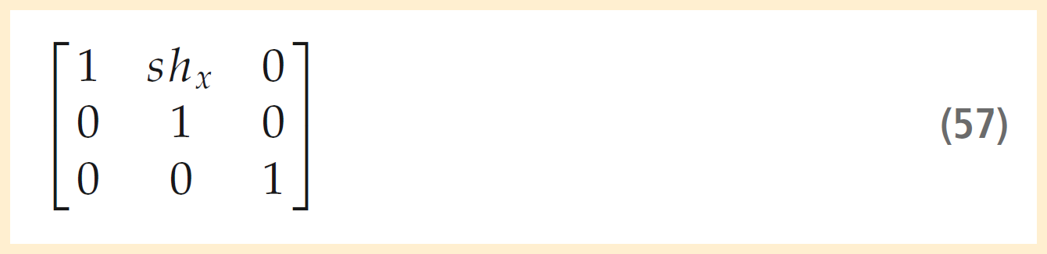
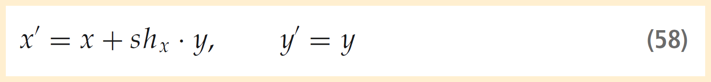
Shear
A transformation that distorts the shape of an object such that the transformed shape appears as if the object were composed of internal layers that had been caused to slide over each other is called a shear.
Two common shearing transformations are those that shift coordinate x values and those that shift y values.
An x-direction shear relative to the x axis is produced with the transformation matrix
which transforms coordinate positions as
Notes:
Any real number can be assigned to the shear parameter shx.
A coordinate position(x, y) is then shifted horizontally by an amount proportional to its perpendicular distance (y value) from the x axis.

Slide 58
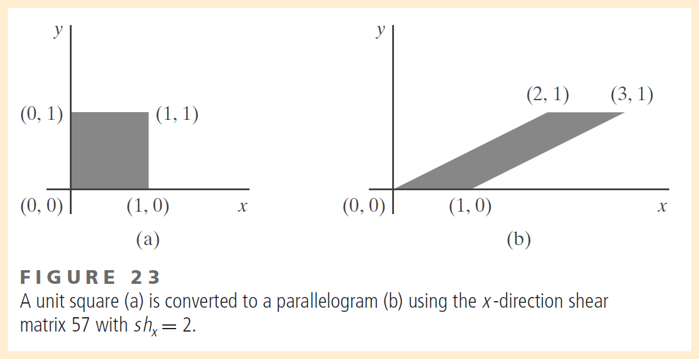
Shear
Setting parameter shx to the value 2, will change the square in Figure 23 into a parallelogram.
Negative values for shx shift coordinate positions to the left.

Slide 59
OpenGL Functions for Two-Dimensional Geometric Transformations
Translation
Function Syntax | Description | Example
glTranslate* (tx, ty, tz); | Translation parameters tx, ty, and tz can be assigned any real-number values, and the single suffix code to be affixed to this function is either f (float) or d (double). | glTranslatef (25.0, -10.0, 0.0);

Slide 60
OpenGL Functions for Two-Dimensional Geometric Transformations
Rotation
Function Syntax | Description | Example
glRotate* (theta, vx, vy, vz); | The vector v = (vx, vy, vz) can have any floating-point values for its components. This vector defines the orientation for a rotation axis that passes through the coordinate origin. The suffix code can be either f or d, and parameter theta is to be assigned a rotation angle in degrees. | glRotatef (90.0, 0.0, 0.0, 1.0);

Slide 61
OpenGL Functions for Two-Dimensional Geometric Transformations
Scaling
Function Syntax | Description | Example
glScale* (sx, sy, sz); | The suffix code is again either f or d, and the scaling parameters can be assigned any real-number values. Scaling in a two-dimensional system involves changes in the x and y dimensions, so a typical two-dimensional scaling operation has a z scaling factor of 1.0 (which causes no change in the z coordinate of positions). | glScalef (2.0, -3.0, 1.0);

Slide 62
OpenGL Matrix Operations
The glMatrixMode routine is used to set the projection mode, which designates the matrix that is to be used for the projection transformation.
This transformation determines how a scene is to be projected onto the screen.
We use the same routine to set up a matrix for the geometric transformations.

Slide 63
OpenGL Matrix Operations
In this case, however, the matrix is referred to as the modelview matrix, and it is used to store and combine the geometric transformations.
It is also used to combine the geometric transformations with the transformation to a viewing-coordinate system.
We specify the modelview mode with the statement
glMatrixMode (GL_MODELVIEW);
which designates the 4×4 modelview matrix as the current matrix.

Slide 64
OpenGL Matrix Operations
In this case, however, the matrix is referred to as the modelview matrix, and it is used to store and combine the geometric transformations.
It is also used to combine the geometric transformations with the transformation to a viewing-coordinate system.
We specify the modelview mode with the statement
glMatrixMode (GL_MODELVIEW);
which designates the 4×4 modelview matrix as the current matrix.
With the following function, we assign the identity matrix to the current matrix:
glLoadIdentity ( );

Slide 65
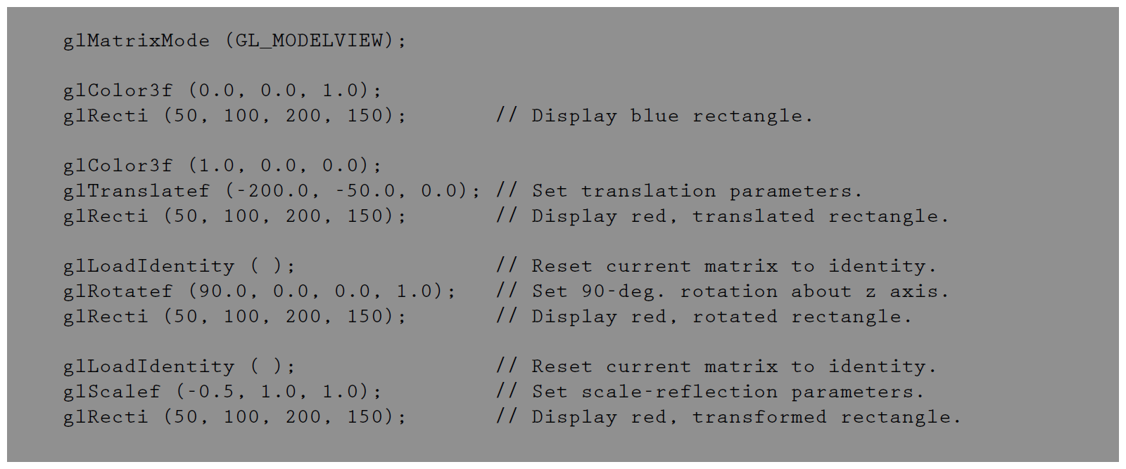
OpenGL Geometric-Transformation Programming Examples

Slide 66
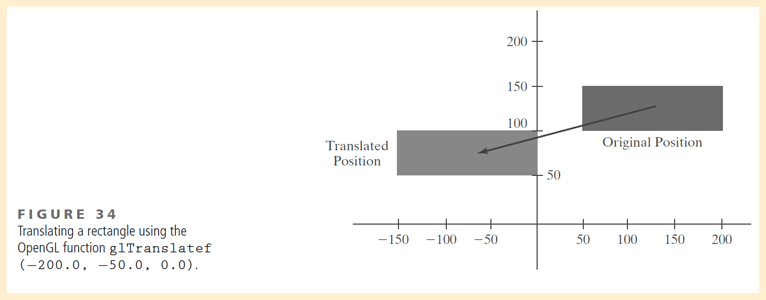
OpenGL Geometric-Transformation Programming Examples

Slide 67
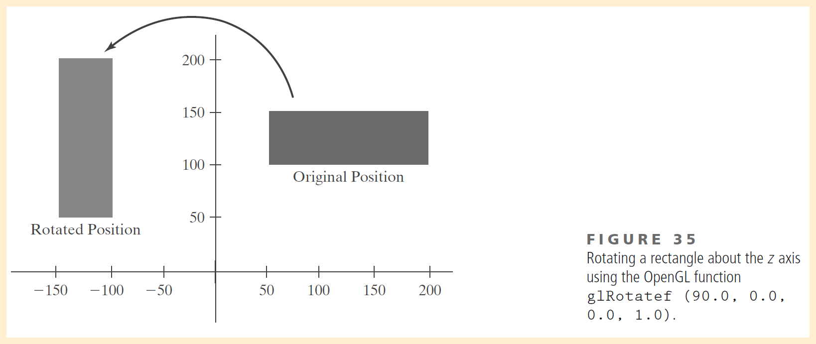
OpenGL Geometric-Transformation Programming Examples

Slide 68
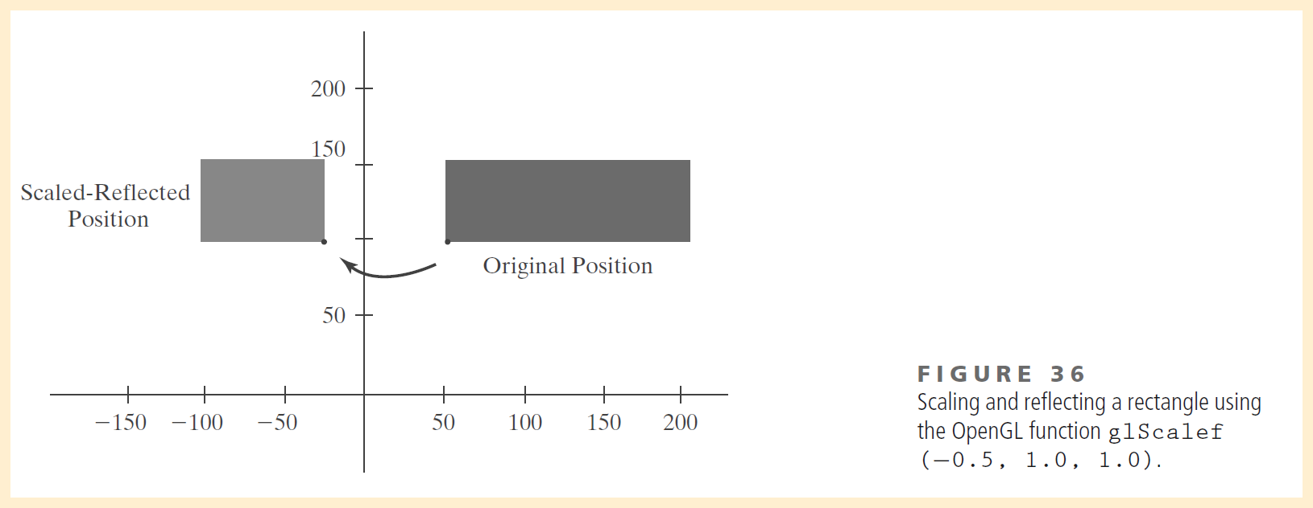
OpenGL Geometric-Transformation Programming Examples

Slide 69
وصلّى الله وبارك على نبيّنا محمد
The End Summary of Chapter Six T.Mariah Khayat الأستاذة/ مارية خياط Adham University College الكلية الجامعية بأضم mskhayat@uqu.edu.sa

